Slide 1

Movie Recommendation System Using Apache Spark and Python
#1
End-to-end Big Data Project To Build A Movie Recommendation System Using
Apache Spark and Python.
Final Project Status Report
BRIGHT KYEREMEH

Slide 2
Movie Recommendation System Using Apache Spark and Python
Introduction
In today's world, recommendation systems are widely used to help people make choices by suggesting items based on their preferences. One of the most popular examples of recommendation systems is the movie recommendation system. Building a movie recommendation system is a big data project that involves collecting data from various sources, preprocessing it, extracting features, building models, evaluating performance, and deploying the system. In this report, we will discuss an end-to-end big data project that involves building a movie recommendation system using Apache Spark and Python.
End-to-end Big Data Project To Build A Movie Recommendation System Using
Apache Spark and Python.
BRIGHT KYEREMEH

Slide 3
Movie Recommendation System Using Apache Spark and Python
Data Collection:
The first step of this project is to collect movie data from various sources such as IMDb, Rotten Tomatoes, etc. We used web scraping techniques to extract the required data and stored it in a Hadoop Distributed File System (HDFS). We collected data such as movie title, director, cast, genre, release year, rating, and reviews. The collected data was in unstructured format, so we had to preprocess it before we could extract features.
End-to-end Big Data Project To Build A Movie Recommendation System Using
Apache Spark and Python.
BRIGHT KYEREMEH

Slide 4
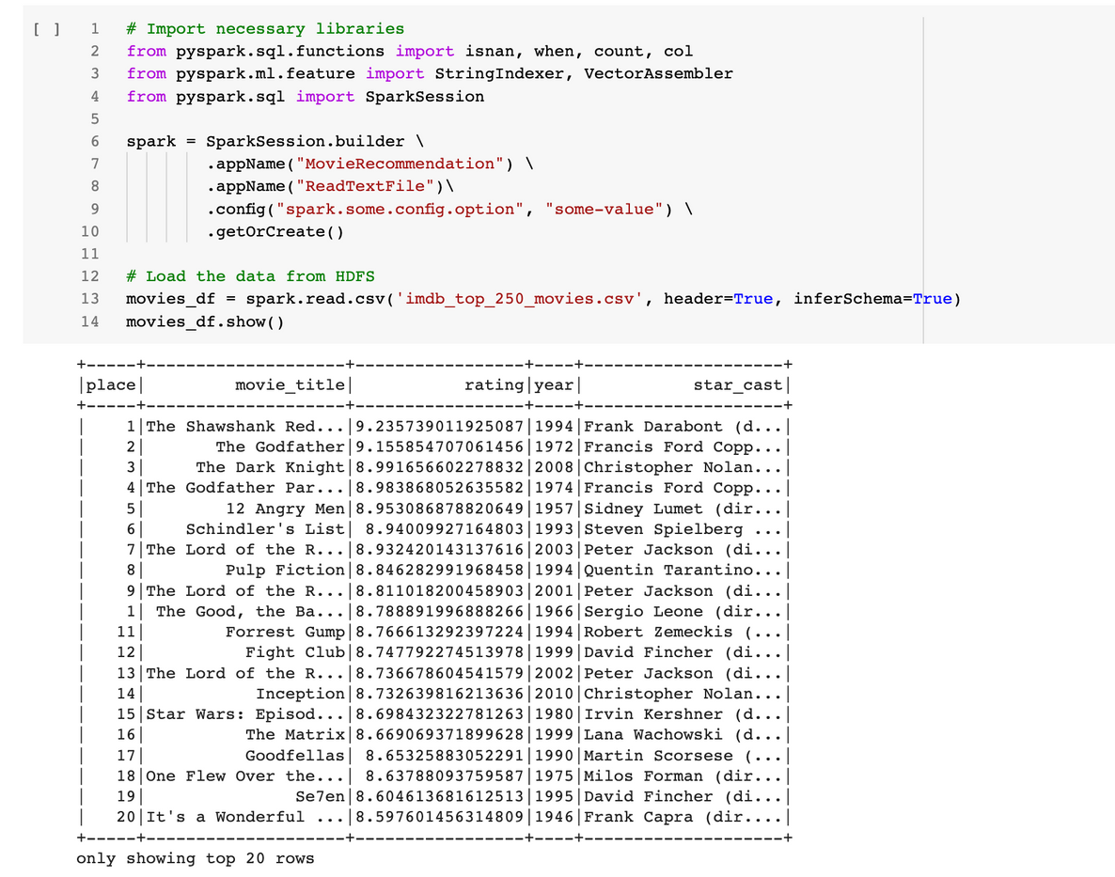
sample dataset output
STEPS
Data Extraction
The data to be used for this project will come from the IMDB database.
01
The dataset is first extracted from the IMDB website via python libraries such as beautiful soup. The dataset is then saved and load from HDFS into spark dataframe.
Loading and exploring data
02
BRIGHT KYEREMEH

Slide 5
Movie Recommendation System Using Apache Spark and Python
Data Preprocessing:
The second step was to preprocess the collected data to clean and prepare it for analysis. This involved techniques such as removing duplicates, handling missing values, and performing feature engineering. We used PySpark, the Python API for Apache Spark, to perform these tasks in a distributed manner. PySpark allowed us to process big data efficiently by distributing the data across a cluster of machines and performing parallel processing.
End-to-end Big Data Project To Build A Movie Recommendation System Using
Apache Spark and Python.
BRIGHT KYEREMEH

Slide 6
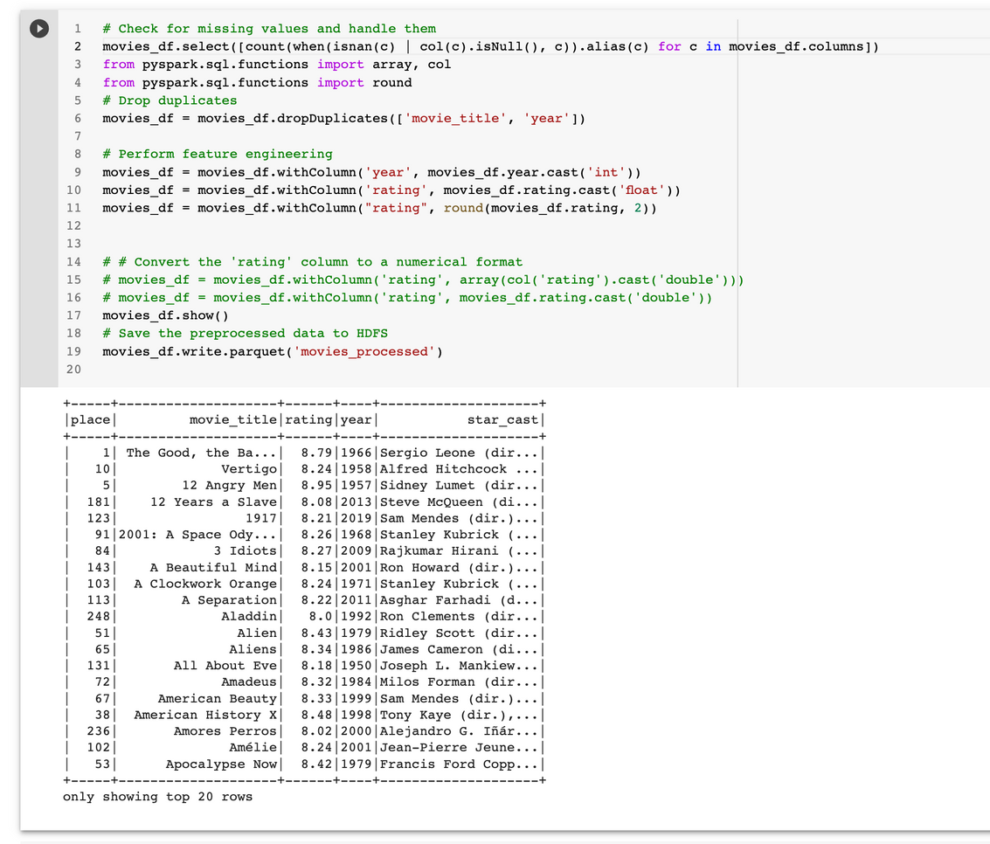
sample dataset output
STEPS
The dataset is then check for:
missing values
dropping duplicate values
feature engineered the year and rating
saved the processed file
Data Preparation
03
BRIGHT KYEREMEH

Slide 7
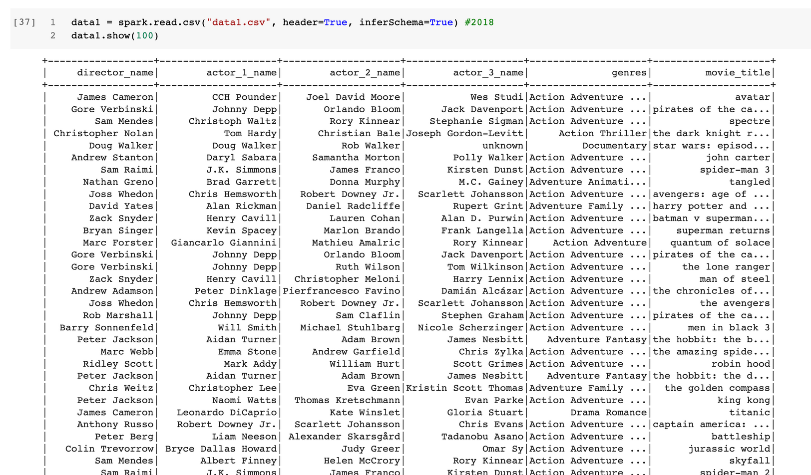
sample dataset output
2018 Data
STEPS
More and current data has been extracted to include data on directors, actors genres and movie titles
Extracted more data from IMDB
01
BRIGHT KYEREMEH

Slide 8
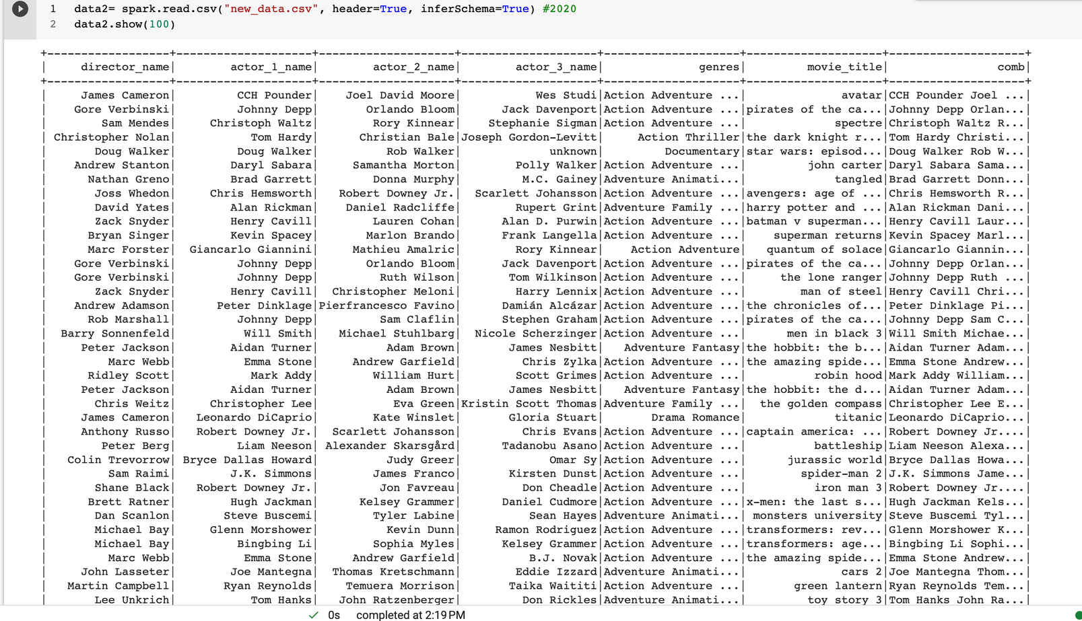
sample dataset output
2019 Data
STEPS
More and current data has been extracted to include data on directors, actors genres and movie titles
Extracted more data from IMDB
01
BRIGHT KYEREMEH

Slide 9
Movie Recommendation System Using Apache Spark and Python
Feature Engineering:
After the data had been preprocessed, we extracted relevant features from the movie data that could be used for recommendation. We used techniques such as collaborative filtering, content-based filtering, and hybrid filtering to extract features. We used PySpark's MLlib library to perform these tasks. Collaborative filtering is a technique that recommends items based on the similarity between users' preferences. Content-based filtering recommends items based on the similarity between the features of the items. Hybrid filtering combines both collaborative and content-based filtering techniques.
End-to-end Big Data Project To Build A Movie Recommendation System Using
Apache Spark and Python.
BRIGHT KYEREMEH

Slide 10
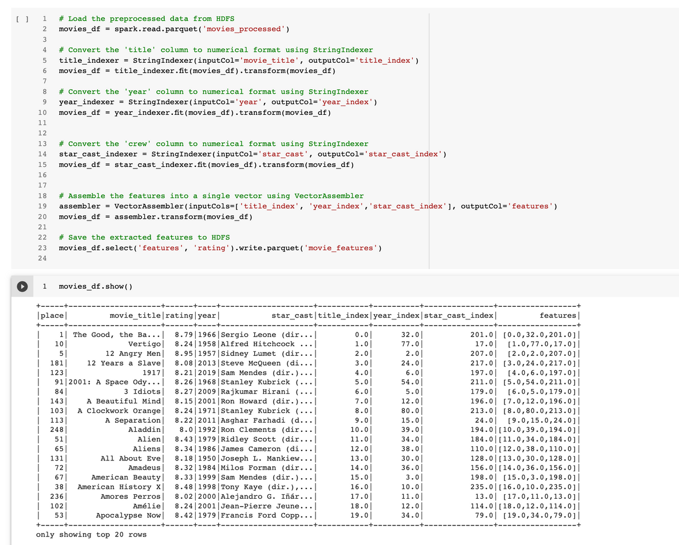
sample dataset output
STEPS
Here we create a column called "feature" which contains index values for the movie titles, year and crew. We will based on this feature to build a recommendation model using Alternating Least Squares (ALS) in pyspark or any other ML algorithm that will work best during the model building stage.
Further feature engineering
04
BRIGHT KYEREMEH

Slide 11
Movie Recommendation System Using Apache Spark and Python
Sentiment Analyzer:
We also built a sentiment analyzer to predict the reviews of the movie. In this case, we use the reviews data from IMDB to perform this task. We save this model which will be deployed during the deployment stage of our project.
End-to-end Big Data Project To Build A Movie Recommendation System Using
Apache Spark and Python.
BRIGHT KYEREMEH

Slide 12
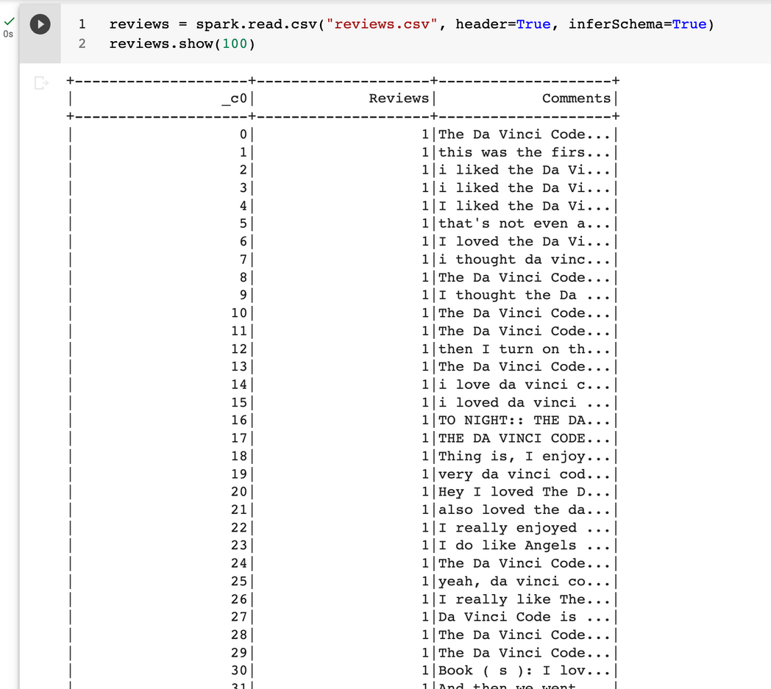
sample dataset output
STEPS
Extracted Reviews from IMDB
Reviews for the various movies have been extracted for performing sentiment analysis.
01
BRIGHT KYEREMEH

Slide 13
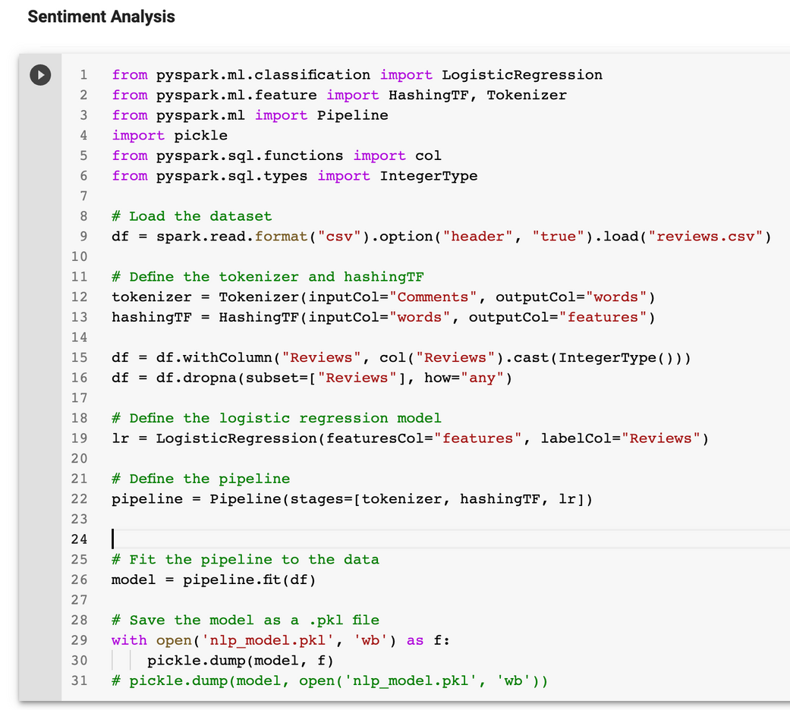
Sample Code
STEPS
I used the reviews and comments to build a sentiment analyzer and saved the model which will be incorporated in the movie recommendation app
Building a Sentiment Analyzer
01
BRIGHT KYEREMEH

Slide 14
Movie Recommendation System Using Apache Spark and Python
Model Building
We used the famous Alternating Least Squares(ALS) from
pyspark.ml.recommendation to build the model and saved it which can be used during the deployment stage.
End-to-end Big Data Project To Build A Movie Recommendation System Using
Apache Spark and Python.
BRIGHT KYEREMEH

Slide 15
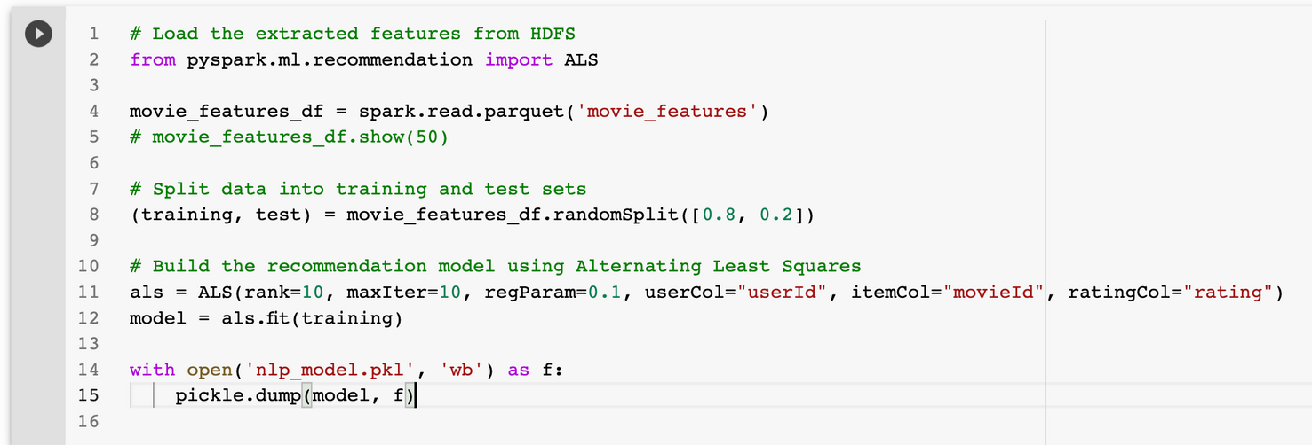
STEPS
Sample Code
I build the ML model using Alternating Least Squares
and saved it ready for deployment
Building and saving the model
01
BRIGHT KYEREMEH

Slide 16
Task
Preparing Files For Deployment
I will need to create the necessary files such as:
main.py
requirement.txt
static (for css)
templates (for html)
01
Preparing for deployment
In this project, we used python Flask API to deploy the model. In order to successfully deploy the project, we needed to create some important files as described herein.
This is where we create our Python API connector to be able to read our model and make recommendations via the API. We also connect to the HTML and CSS file for our App interface here.
02
Main.py
requirement.txt
The requirement.txt file contains all the library requirements that need to be installed in order to use these libraries in the main.py during deployment.
03
Static & templates
The static file contains the CSS of the app interface. The templates file contains the html code that builds the framework of our app.
04
BRIGHT KYEREMEH

Slide 17
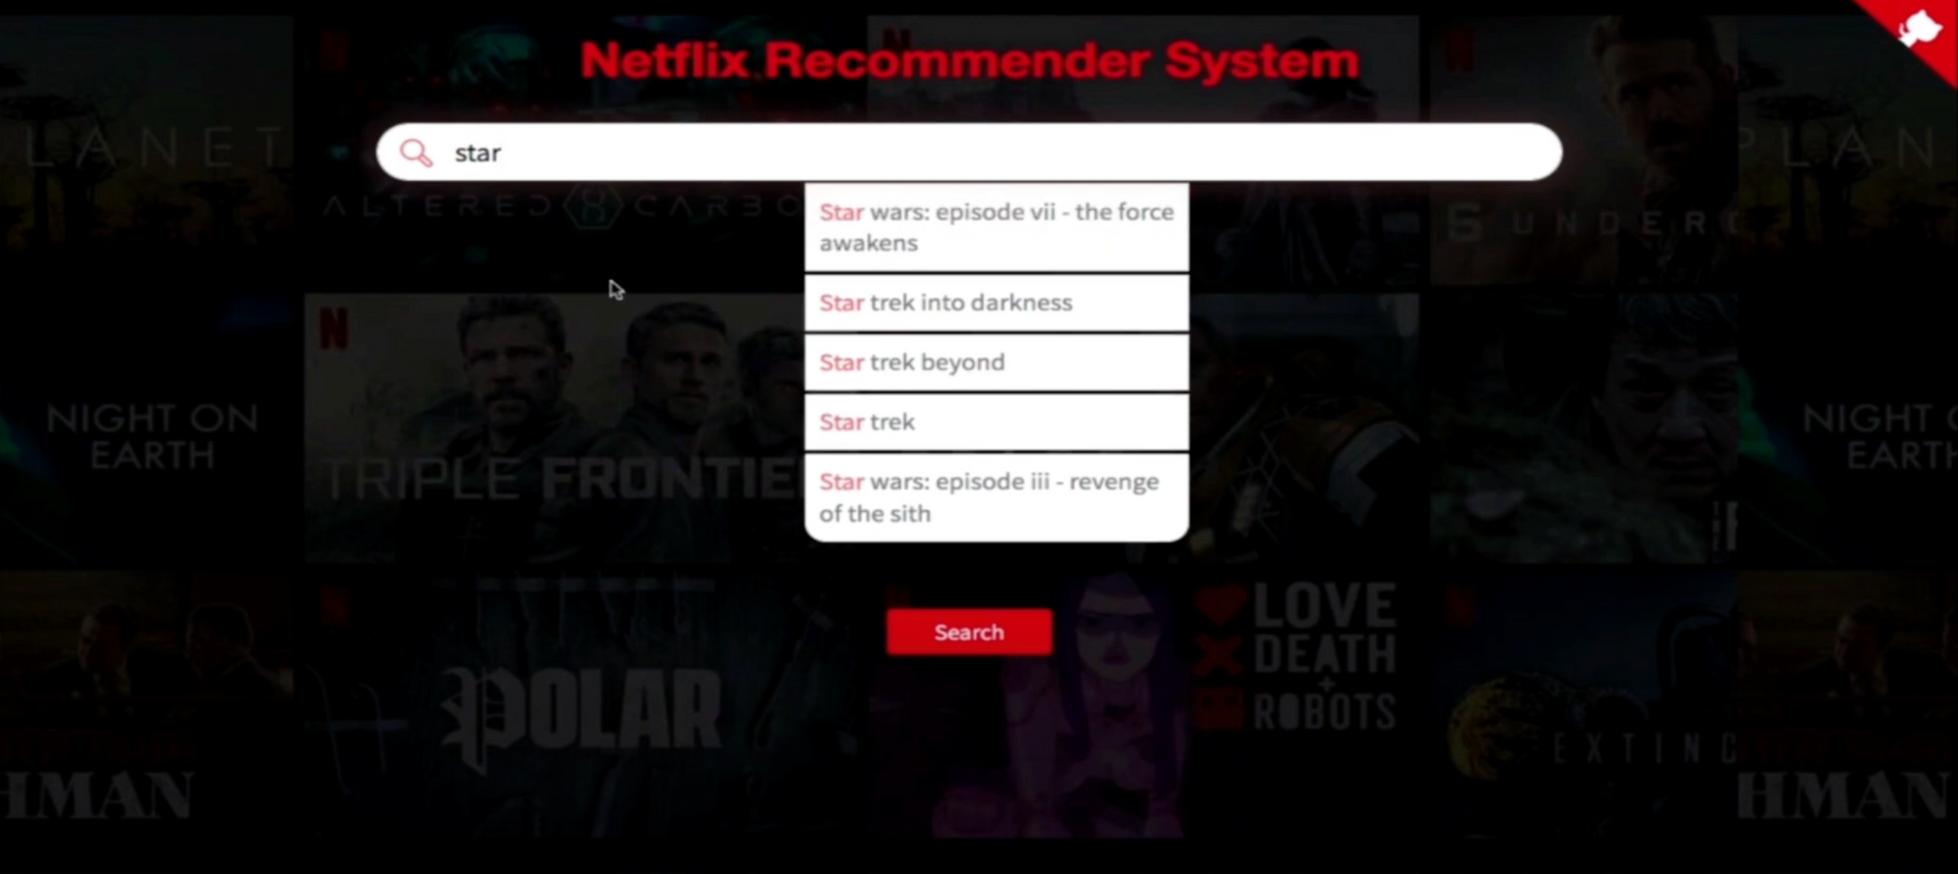
Movie Recommendation System Using Apache Spark and Python
App Interface
The recommendation system has a search bar and a auto suggestion based on the keys word inputs from the user. In the following example, the user seeks to search "star wars" and as the user starts to type "star" the app auto suggest possible movies that starts with that keyword.
End-to-end Big Data Project To Build A Movie Recommendation System Using
Apache Spark and Python.
BRIGHT KYEREMEH

Slide 18
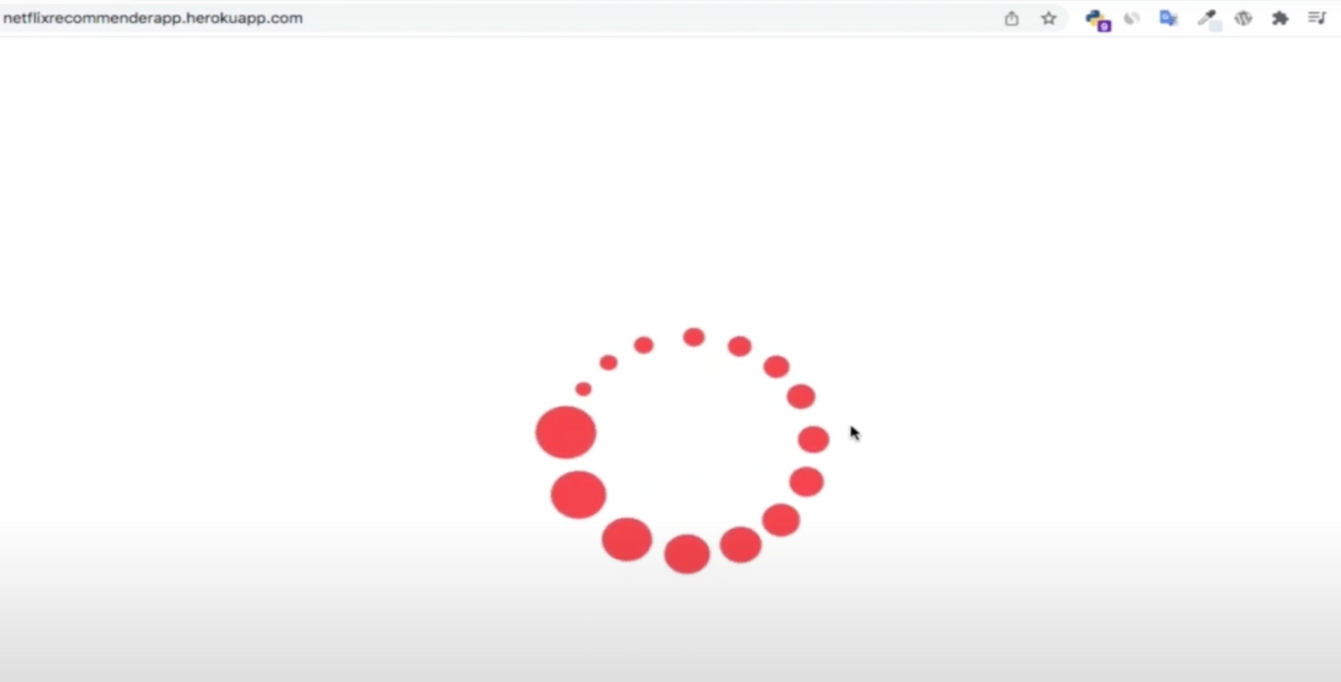
Movie Recommendation System Using Apache Spark and Python
App Interface
The recommendation system also has a search or loading animation that runs anytime a user searches for a movie in the system.
End-to-end Big Data Project To Build A Movie Recommendation System Using
Apache Spark and Python.
BRIGHT KYEREMEH

Slide 19
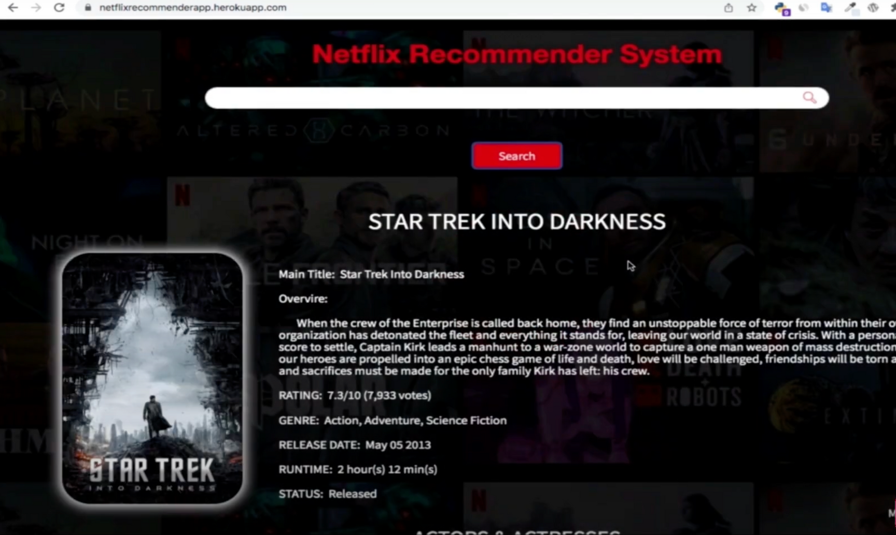
Movie Recommendation System Using Apache Spark and Python
App Interface
After the user searches something in the recommendation system, the system returns the movie along with descriptions of the movie.
End-to-end Big Data Project To Build A Movie Recommendation System Using
Apache Spark and Python.
BRIGHT KYEREMEH

Slide 20
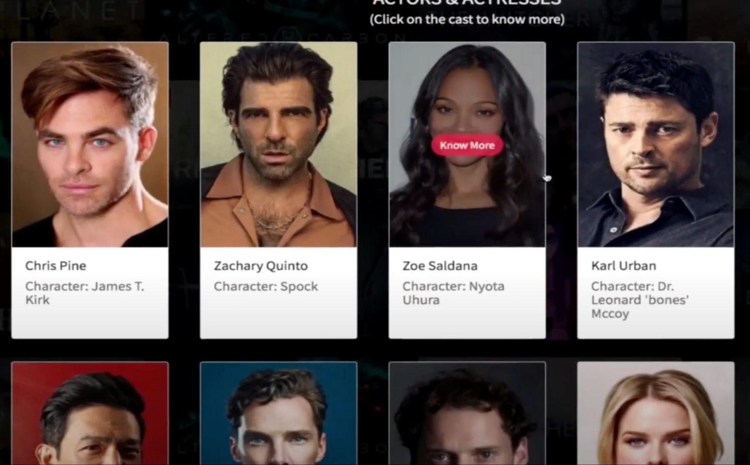
Movie Recommendation System Using Apache Spark and Python
App Interface
The system also returns the actors and actresses in the movie along with their descriptions.
End-to-end Big Data Project To Build A Movie Recommendation System Using
Apache Spark and Python.
BRIGHT KYEREMEH

Slide 21
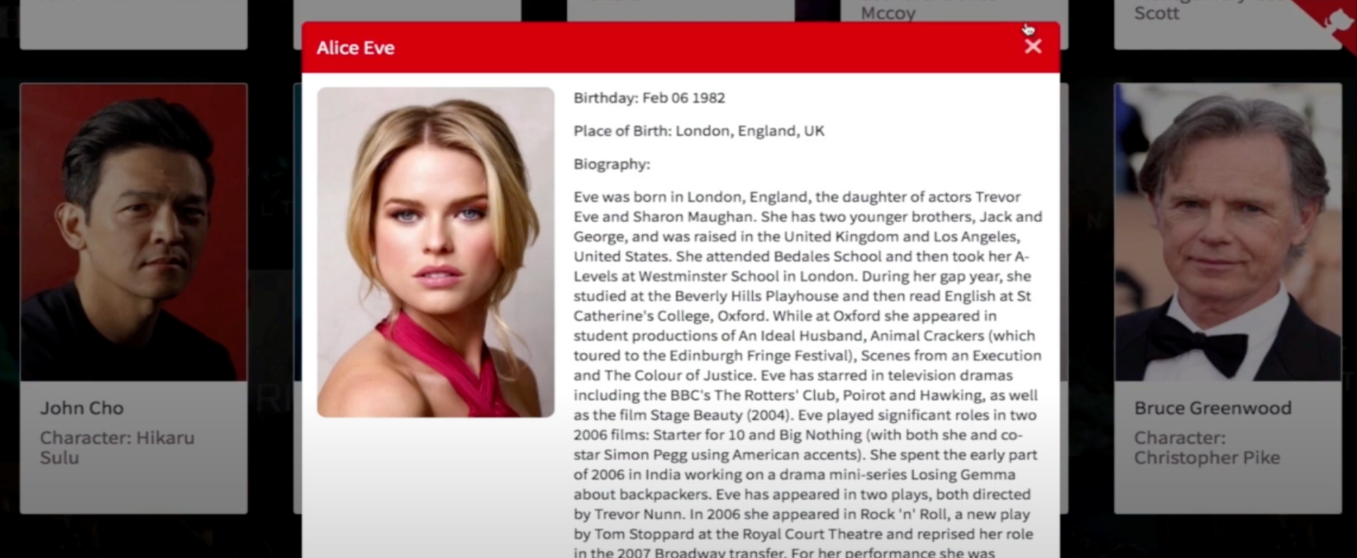
Movie Recommendation System Using Apache Spark and Python
App Interface
The system also returns the actors and actresses in the movie along with their descriptions.
End-to-end Big Data Project To Build A Movie Recommendation System Using
Apache Spark and Python.
BRIGHT KYEREMEH

Slide 22
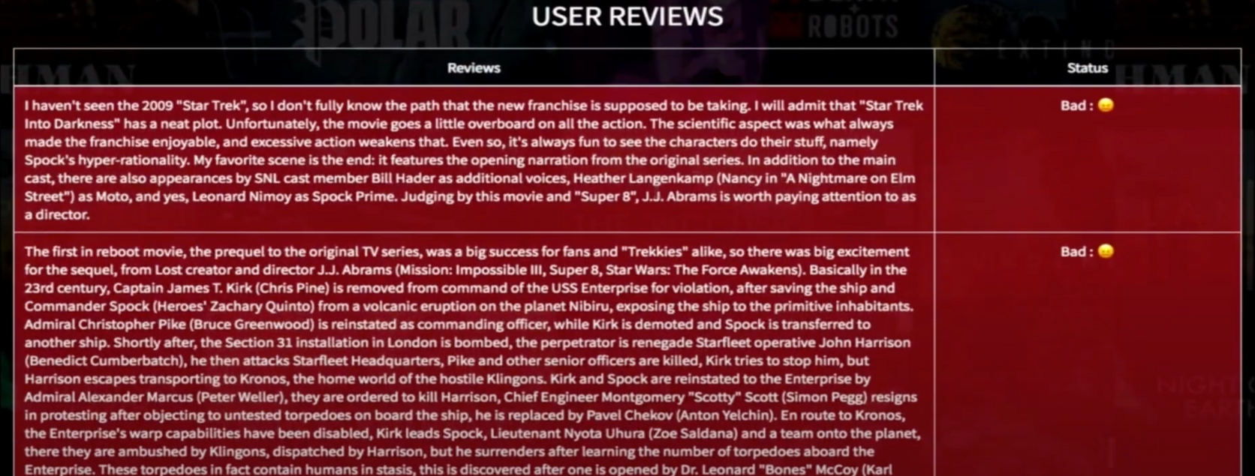
Movie Recommendation System Using Apache Spark and Python
App Interface
The system also returns the reviews of the movies and use the reviews model to predict the reviews status of the movie as bad or good.
End-to-end Big Data Project To Build A Movie Recommendation System Using
Apache Spark and Python.
BRIGHT KYEREMEH

Slide 23
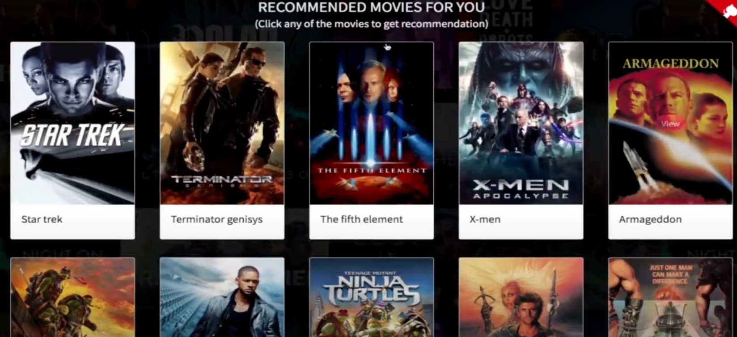
Movie Recommendation System Using Apache Spark and Python
App Interface
The system also returns recommendations for the user similar to what the user has already search.
End-to-end Big Data Project To Build A Movie Recommendation System Using
Apache Spark and Python.
BRIGHT KYEREMEH

Slide 24

The project deliverables can be found at the github repository provided below:
Github Link: https://github.com/MrBriit/Big-data-project
Deliverables
Github

Slide 25
Week 1: Data collection
Week 2 : Data preprocessing
Week 3: Performing feature extraction
Week 4: Building machine learning using PySpark's MLlib
Week 5: Evaluating and tuning the model for best performance
Week 6: Deployment and integration of the model using Python flask or Heroku cloud or other cloud platforms as described above
Weekly Schedule/Milestone
BRIGHT KYEREMEH

